Slide 1
NIPPOLOG 1.0.34

Slide 2
INTRODUCTION
Nippolog Software
Data logging in PC.
Generating records. (printouts, excel sheet)

Slide 3
FEATURES
Maximum 64 channels can be read in software.
Supports MODBUS Protocol for all baud rates.
Data can be viewed in tabular as well as graphical form.
Programmable Baud rate.
Multiple users can be created.
Password protection for security purpose.

Slide 4
SPECIFICATIONS
Nippolog Software
Nippolog Designer: Projects can be created and customized using designer.
Nippolog Scanner: Projects created in designer are viewed in scanner for data logging.

Slide 5
DESIGNER
Communication:
COMM Port selection and COMM settings
Slave assignment to communication port
Tags of each slave to be assigned
Display:
Tags display format
Colour of Tags viewed in Scanner

Slide 6
SCANNER
Project Display
Data scanning interval (Adjustable scan rate)
Online data in screen, list, grid & chart view.
Data backup file generated as per the interval set.
Can create multiple users.
Data records in printouts and excel.

Slide 7
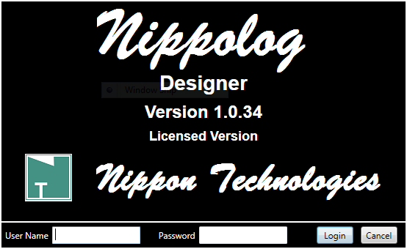
NIPPOLOG DESIGNER:

Slide 8
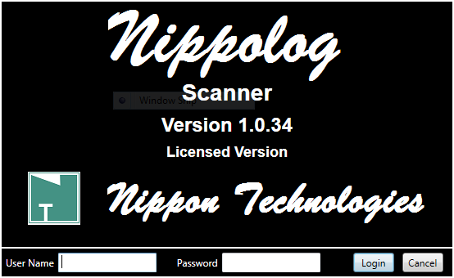
NIPPOLOG SCANNER:

Slide 9
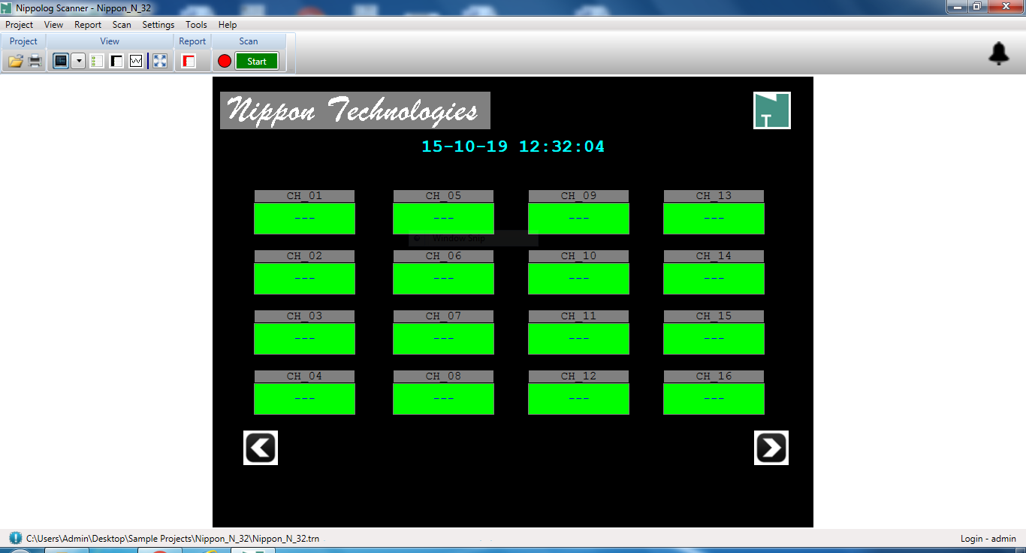
SCREEN VIEW:

Slide 10
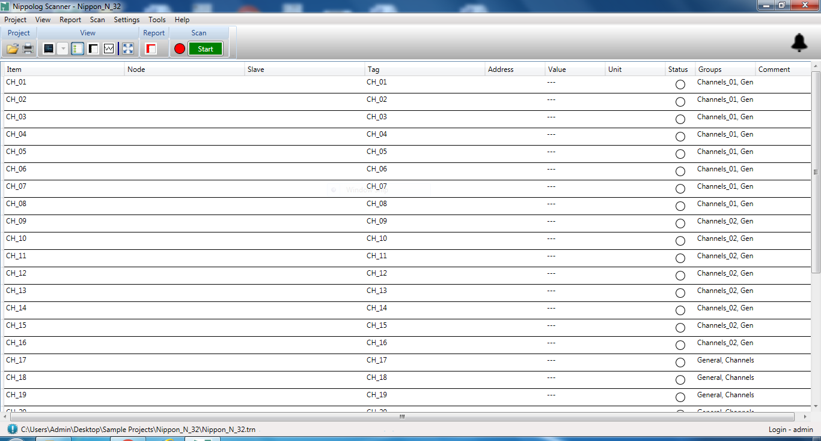
LIST VIEW:

Slide 11
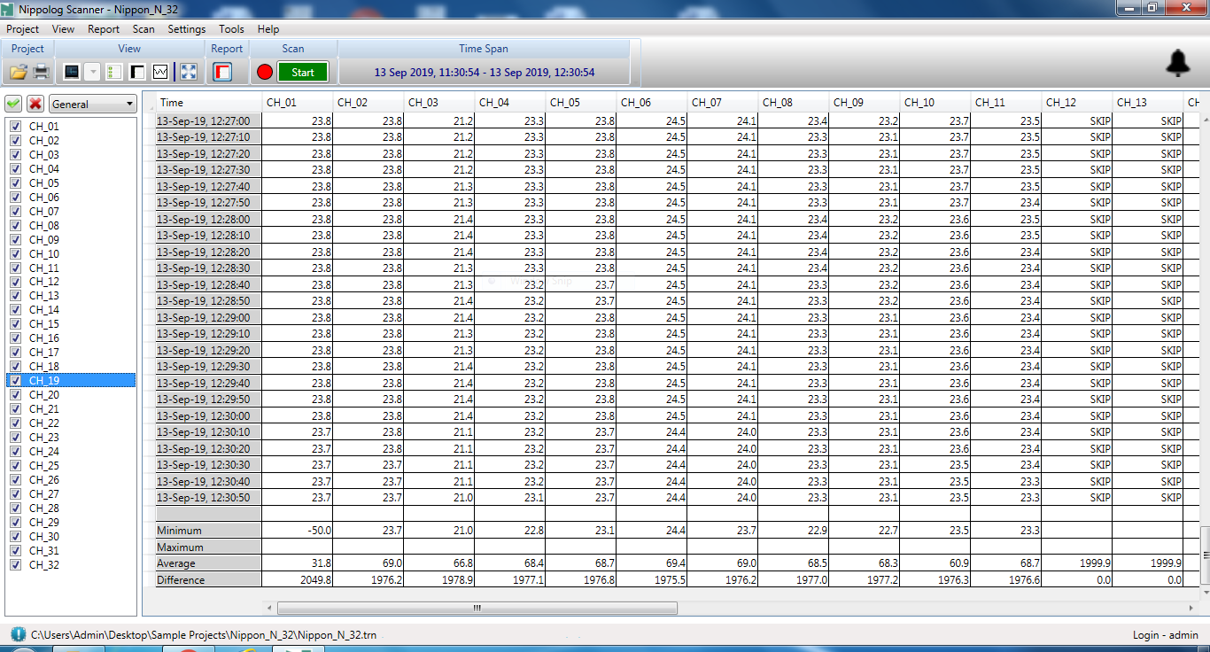
GRID VIEW:

Slide 12
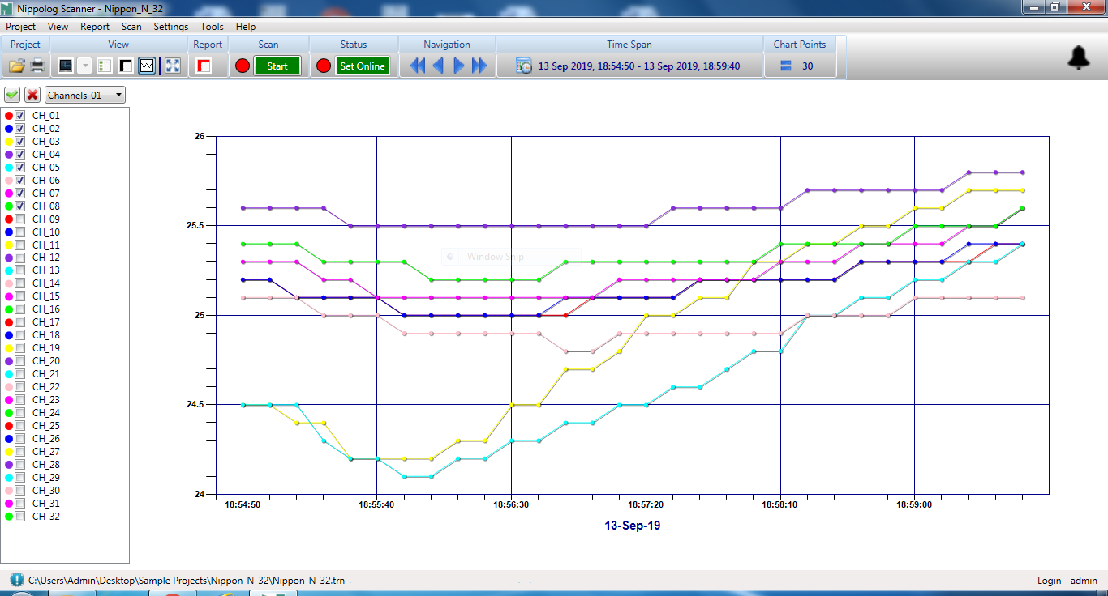
CHART VIEW:

Slide 13
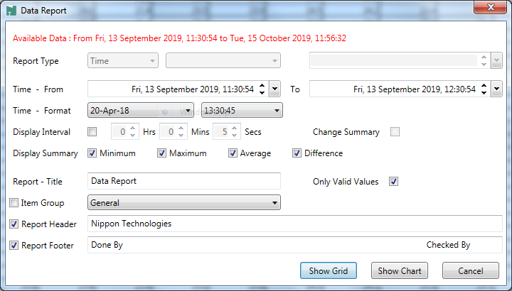
REPORT SETTINGS:

Slide 14
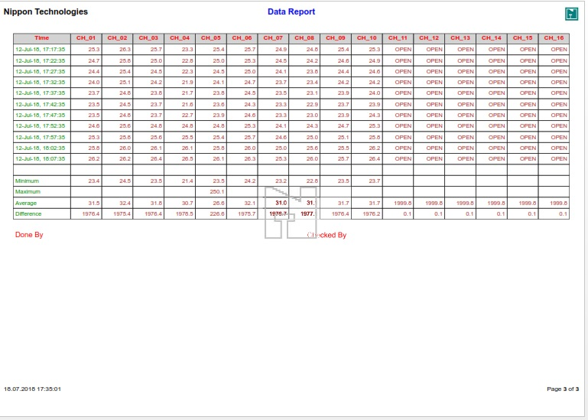
GRID VIEW REPORT

Slide 15
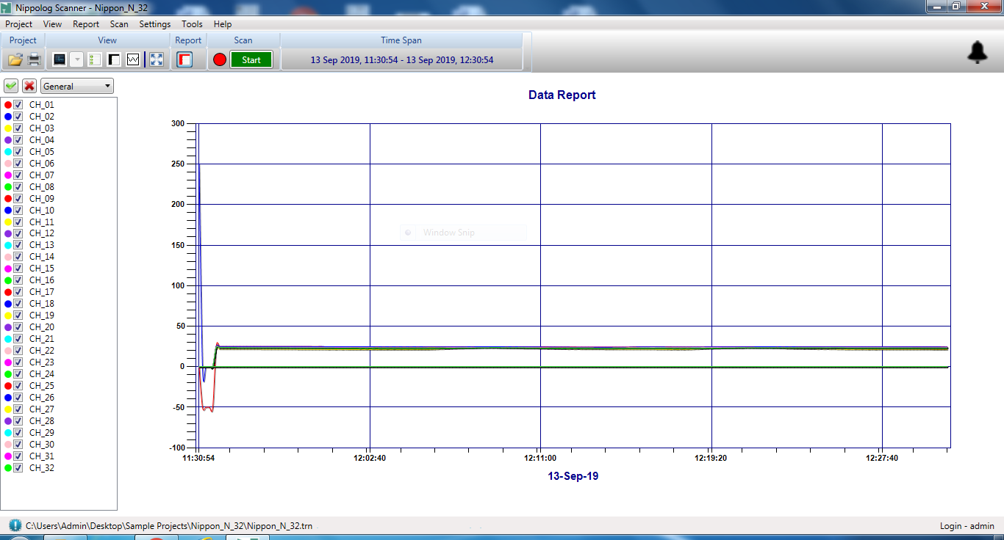
CHART VIEW REPORT:

Slide 16
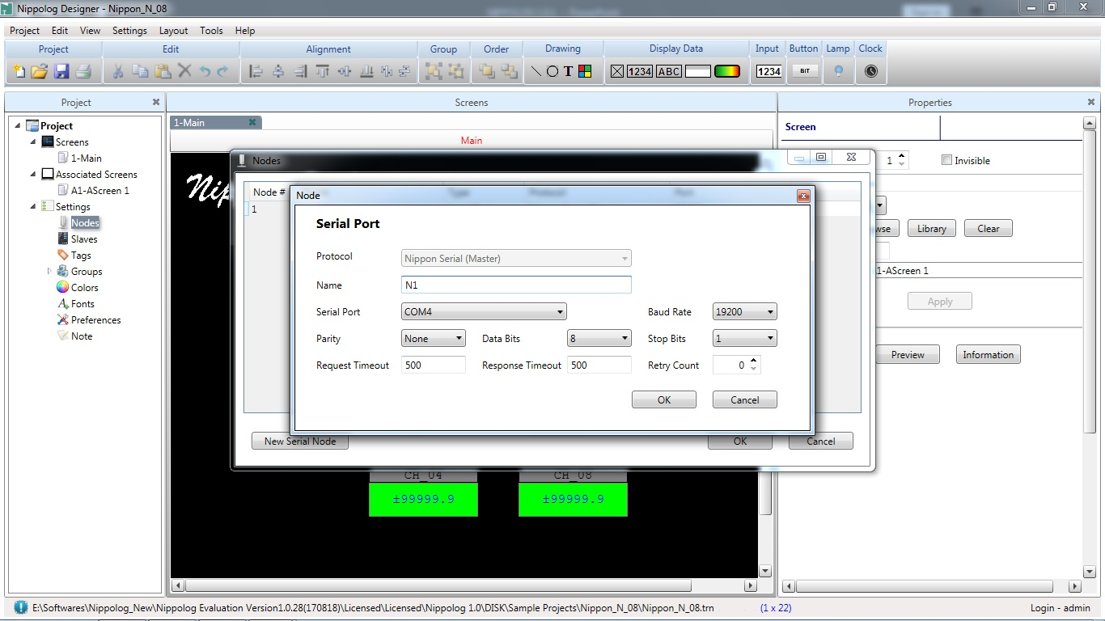
COMMUNICATION SETTINGS

